Slide 1
HEART DISEASE PREDICTION

Slide 2
INTRODUCTION
The project involved analysis of the heart disease patient dataset with proper data processing. Then, different models were trained and and predictions are made with different algorithms KNN, Decision Tree, Random Forest,Naïve Bayes,Logistic Regression etc This is the jupyter notebook code and dataset I've used for my Kaggle kernel 'Binary Classification with Sklearn and Keras.
we've used a variety of Machine Learning algorithms, implemented in Python, to predict the presence of heart disease in a patient. This is a classification problem, with input features as a variety of parameters, and the target variable as a binary variable, predicting whether heart disease is present or not.

Slide 3
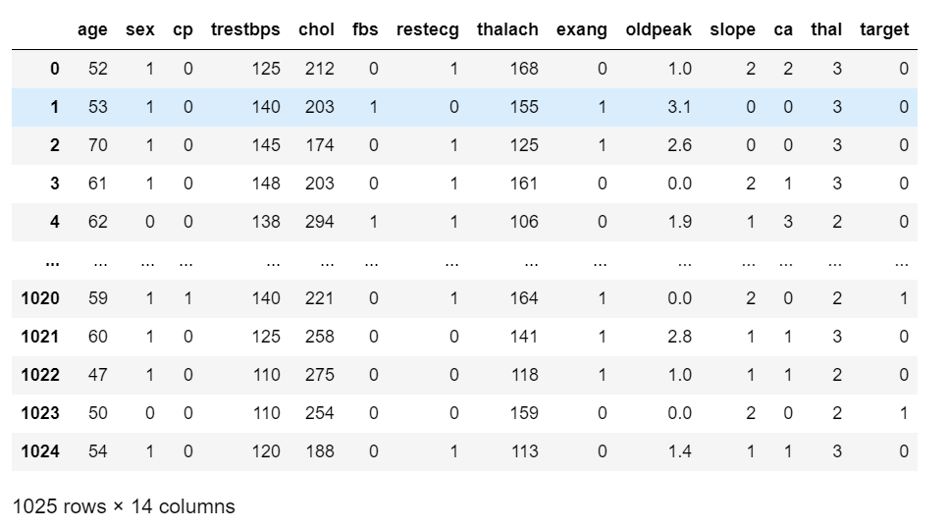
DATASET
age: age sex: 1: male, 0: female
cp: chest pain type, 1: typical angina, 2: atypical angina, 3: non-anginal pain, 4: asymptomatic
trestbps: resting blood pressure
chol: serum cholestoral in mg/dl
fbs: fasting blood sugar > 120 mg/dl
restecg: resting electrocardiographic results (values 0,1,2)
thalach: maximum heart rate achieved
exang: exercise induced angina
oldpeak: oldpeak = ST depression induced by exercise relative to rest
slope: the slope of the peak exercise ST segment
ca: number of major vessels (0-3) colored by flourosopy
thal: thal: 3 = normal; 6 = fixed defect; 7 = reversable defect

Slide 4
Methodology
Importing Essential Libraries
Data Collection and Preprocessing
Importing Dataset
Exploratory Data Analysis
Feature Selection
Train Test Split
Model Fitting

Slide 5
Importing Essential Libraries:
NumPy: For numerical operations.
Pandas: For data manipulation and analysis.
Matplotlib/Seaborn: For data visualization.
Scikit-learn: For machine learning models and evaluation.
Data Collection and Preprocessing:
Data Collection: This step involves gathering the dataset from a source, such as CSV files, databases, or APIs.
Preprocessing: Raw data often contains missing values, duplicate records, or irrelevant features. Preprocessing includes:
Handling missing values.
Removing duplicates.

Slide 6
Importing Dataset
Exploratory Data Analysis (EDA)
EDA involves examining the dataset’s structure, relationships between variables, and identifying patterns or outliers. Techniques include:
Descriptive statistics: Summarizing data using mean, median, standard deviation, etc.
Visualization: Using plots (bar charts, histograms, heatmaps) to understand distributions and correlations.
Identifying correlations: Checking how variables relate to each other, often using correlation matrices.

Slide 7
Train-Test Split:
The dataset is split into training and testing sets to evaluate the model’s performance on unseen data. This ensures that the model does not overfit the training data
Model Fitting:
The accuracy score achieved using
Logistic Regression is: 83.61 %
Naive Bayes is: 80.33 %
K-Nearest Neighbors is: 65.57 %
Decision Tree is: 85.25 %
Random Forest is: 86.89 %

